Slide 1

Have you ever repaired something that is broken?
What did you fix? Why did you fix it?
How do you feel when you fix things?
If something doesn’t get fixed what happens to it?

Slide 2

Gay Gordon-Byrne Executive Director of The Repair Association on TED X talking about why repair is important.

Slide 3
Gay Gordon-Byrne mentioned the word sustainability?
What does that mean?
How important is sustainability?

Slide 4

This short animated movie explaining sustainability was created for RealEyes by Igloo Animations.

Slide 5
What is a linear economy?
What is a circular economy?
Which one is better? Why?

Slide 6
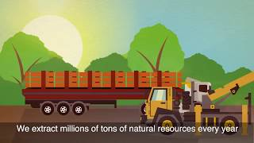
Video explaining circular vs linear economies by the European Environment Agency (EEA).

Slide 7
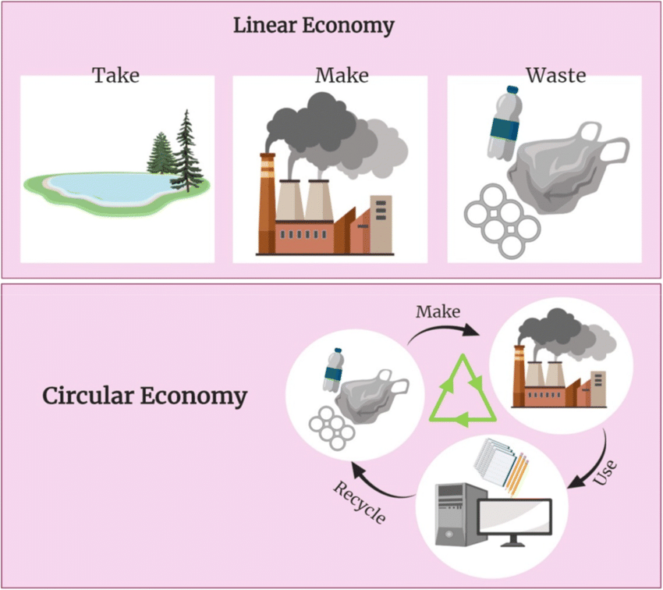
diagram from www.researchgate.net

Slide 8
What happens to items that don’t get repaired?
Why is this a problem?
What is e-waste?

Slide 9
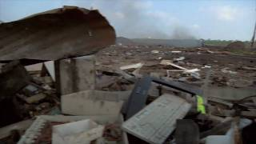
Kyle Wiens, CEO and cofounder of iFixit, talking about the dangers of improper e-waste disposal.

Slide 10
Why don’t we fix more things?
Who do you take your item to when it’s broken?
What are some barriers to repair?

Slide 11
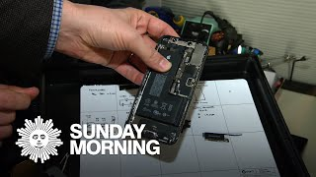
CBS Sunday morning piece about the right to repair movement.

Slide 12
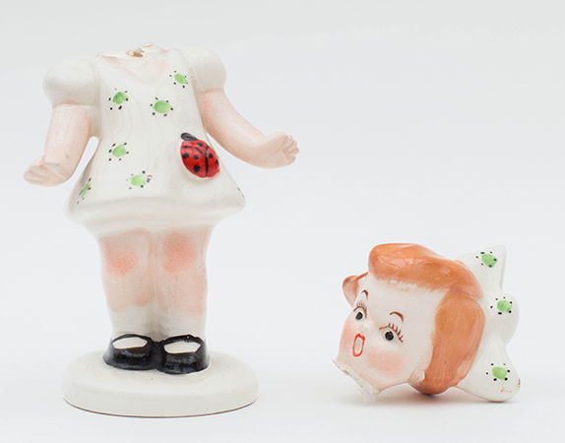
What are other reasons to fix items we own?

Slide 13

An introduction to the British show The Repair Shop.
A show featuring a team of skilled craftspeople who restore beloved broken treasures.

Slide 14
Have you ever repaired something that was irreplaceable?
Do you own something that you know you would fix if it was broken?

